Slide 1
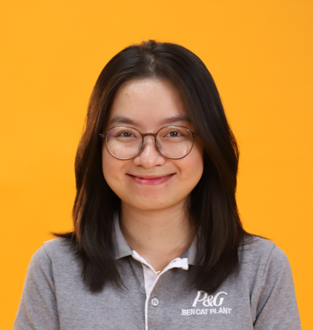


TWFM AMA HR Leader – B3
(Stretch assignment)
HR Leadership Journey
23 sites in AMA, Global Project Team and Influencing Diverse Stakeholders
My Nguyen
MSV PS HR Leader – B2
(Stretch assignment)
New Organization/Culture Penetration
2025 – Till now
2020 - 2023
2019 - 2020
2017 - 2019
2016 - 2017
Site HR Leader – B3
Site HR Leader – B2
450 Ees, 600 contractors
Lead Org through Transformations:
+ Organization design and execution for multiple SNDs (> $150MM)
+ Organization productivity (12% yoy): Separations, ACR Impacts, Unattended Operation.
HR Manager – B1
250 Ees, 400 contractors
Integrated Grooming Business & Culture
Exponential Organization Growth
HRBP Lead
OU transformation from Baby Care to Grooming:
ER/LR and Cultural Transition
Talent Acquisition Lead
700 employees
End to End HR Operations
Employer branding
High Level Recruitment

Slide 2
My Career Highlights
90+ OCS Score in 6 years
Enable $150MM SNDs
Deliver 12% Productivity YoY
Scale Impact beyond Plant
Organization Changes & Transitions
Stabilization & Productivity
Country & Regional Impact
Cultural Transformation
Uphold 90+ culture results for 6 consecutive years
Promoted workforce diversity (genders, generations, PWD, ect) and Local talents
Addressed 1000+ inclusion gaps across machine design, facilities, language & culture to build an INCLUSIVE workplace for ALL
Designed & Executed organization plans to support multiple SNDs in the past 4 years.
Led recurring Org change (50% people changed roles every year), double organization size while ensuring upskilling organization as IWS 5.0 Integrated standards.
Transferred advanced technologies/knowledge from Berlin, US, Poland.
Enable Unattended Operation and productivity priorities
Led separation programs with 8-12% year on year projection
Managed ACR impacts with matured organization
Led Cross-functional and regional partnership in the AMA TWFM network to enhance system equity across 23 sites in AMA
Managed country PS talent council and crossed site talent flow. Influenced Plant Managers, GM toward national talent mindset.

Slide 3
My Career Interests
Strengths: Learning Agility, Partnership & Influencing
What matters to me:
(1) Opportunities to have breadth of experience, (2) Expose to International Environment, (3) Coaching, Developing and Managing Others, (4) Continuous learning of new skills (5) Sought as a Thought Leader
Short term aspirations within next 6 months – 12 months:
Continue to build my breadth and depth of HR knowledge in a new organization and culture & new OU
High visibility/exposure responsibilities that help me to grow long term in P&G
Long term goals:
Regional HR Leader with balanced in-depth HR knowledges and business acumen.
Personal request related to dual career:
Same country or neighboring countries within same region. Aligned to accept split set-up in the next assignment duration.

